Slide 1

Artificial Intelligence
Lecture 4
By/ aly maher abdelfattah

Slide 2
Uniform cost search (ucs)
Use a priority queue (least cost first)
Pop the element with least cost
If two elements have the same cost, use alphabetic order

Slide 3
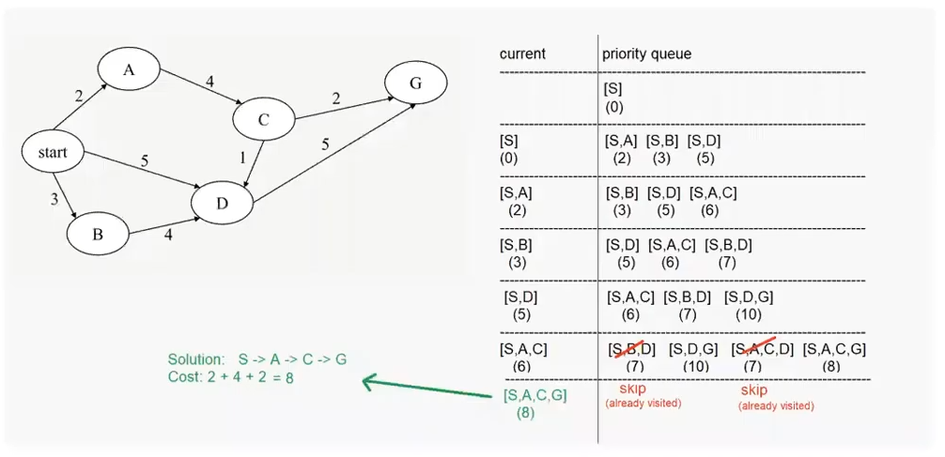
Uniform cost search (ucs)

Slide 4
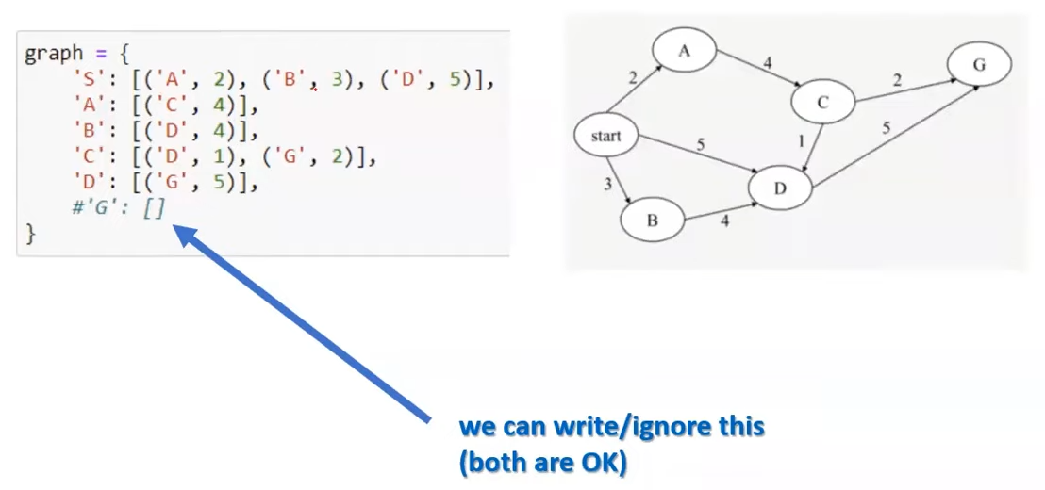
Uniform cost search (ucs) => graph

Slide 5
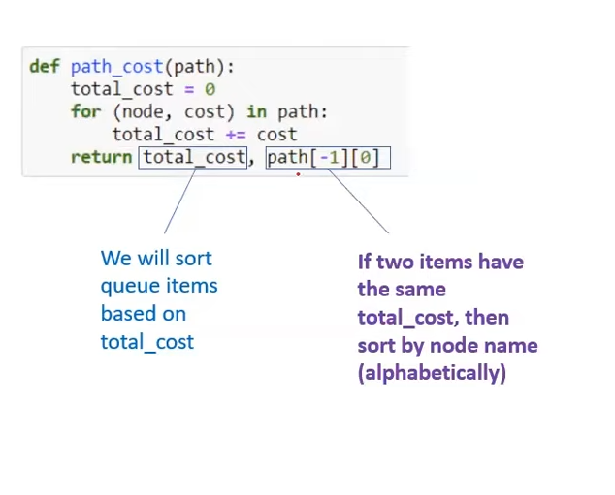
Uniform cost search (ucs) => helper function: path cost

Slide 6
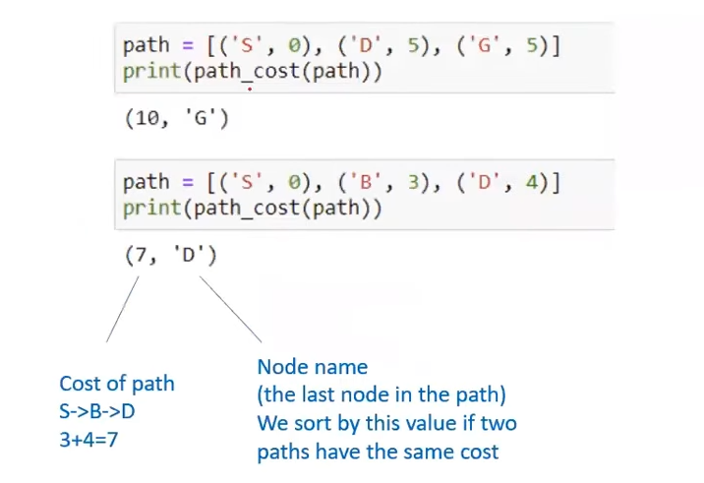
Uniform cost search (ucs) => testing our function with different inputs

Slide 7
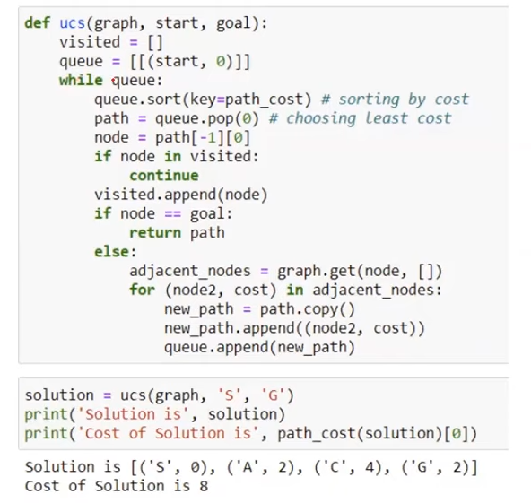
Uniform cost search (ucs) => code

Slide 8
traversal vs search
Traversal: visit each node once
Search: find path between two nodes

Slide 9
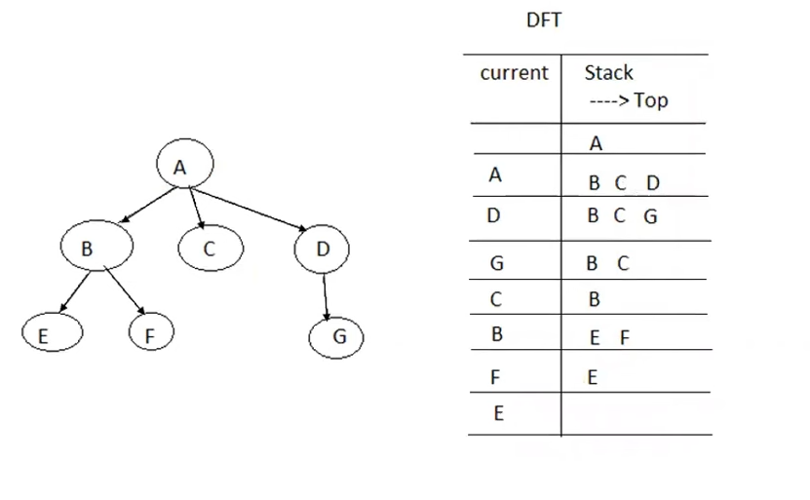
Depth first traversal (dft)

Slide 10
Depth-Limited Search
Similar to depth-first, but with a limit
– i.e., nodes at depth l have no successors
– Overcomes problems with infinite paths
– Sometimes a depth limit can be estimated from the problem description
In other cases, a good depth limit is only known when the problem is solved
– must keep track of the depth
– Same as DFS, we use the stack data structure S1 to record the node we’ve explored. Suppose the source node is node a.

Slide 11

Thank you

